Slide 1
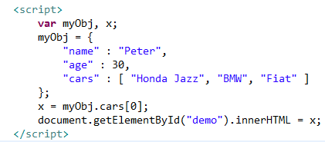
JSON Arrays
Arrays in JSON are almost the same as arrays in JavaScript.
In JSON, array values must be of type string, number, object, array, boolean or null.
In JavaScript, array values can be all of the above, plus any other valid JavaScript expression, including functions, dates, and undefined.
We can access the array values by using the index number

